Slide 1
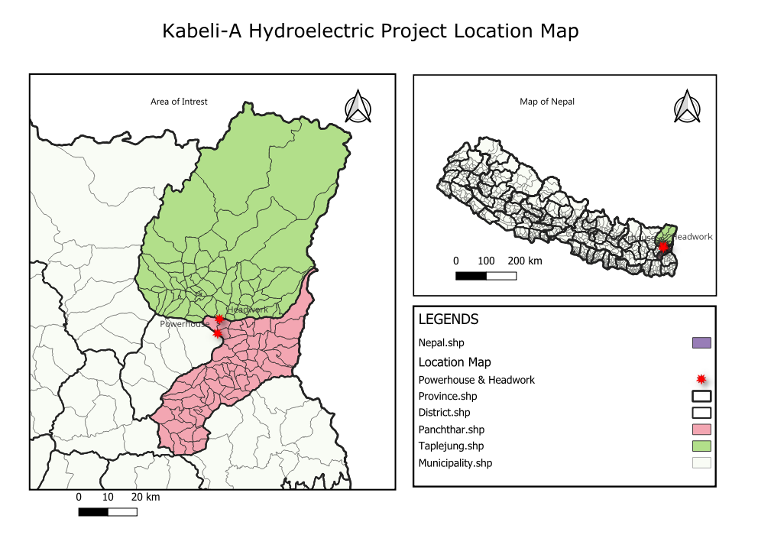
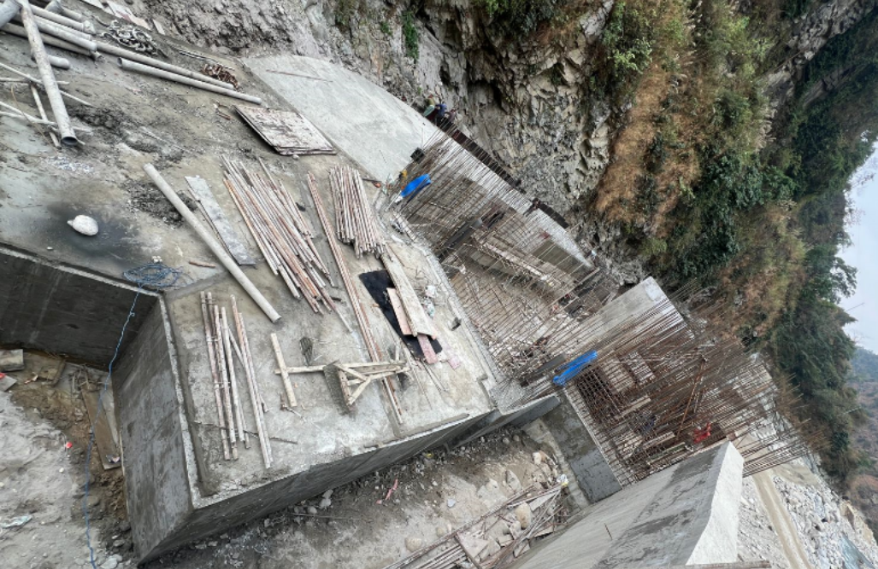
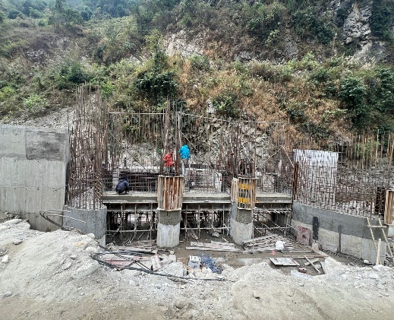
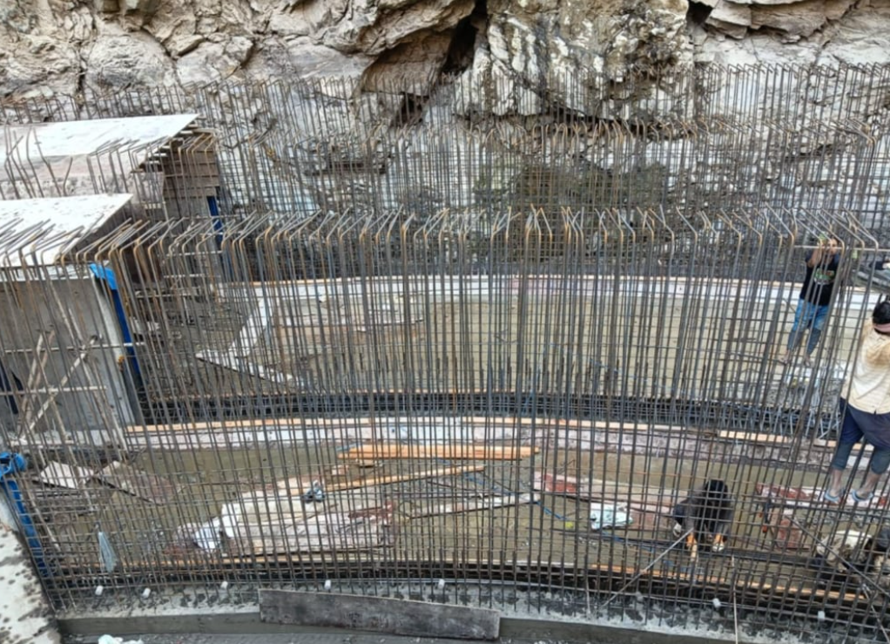
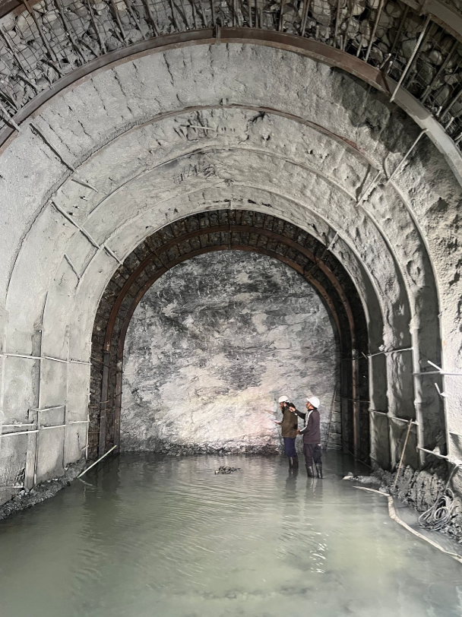
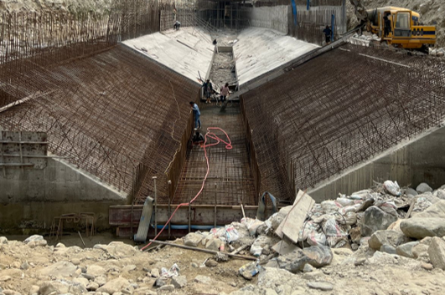
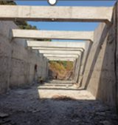
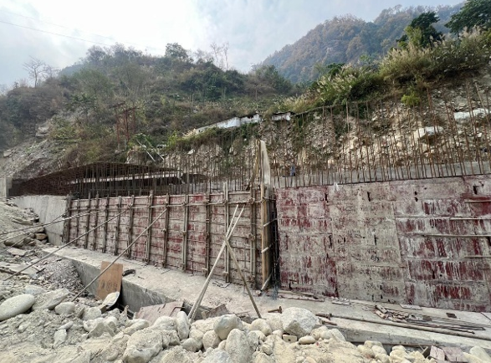
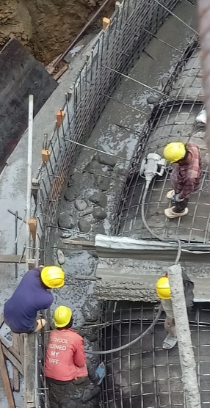
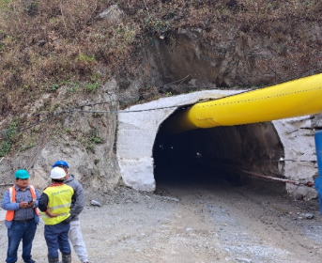
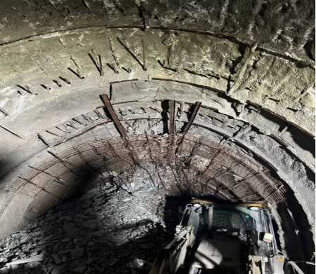
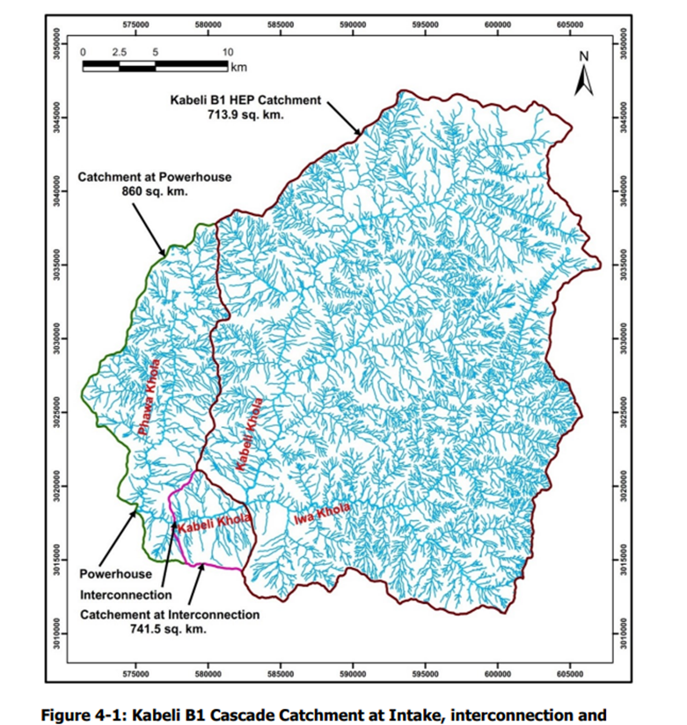
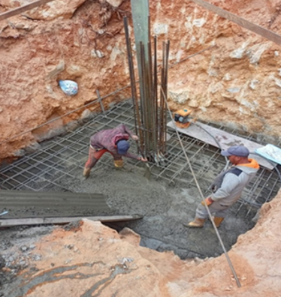
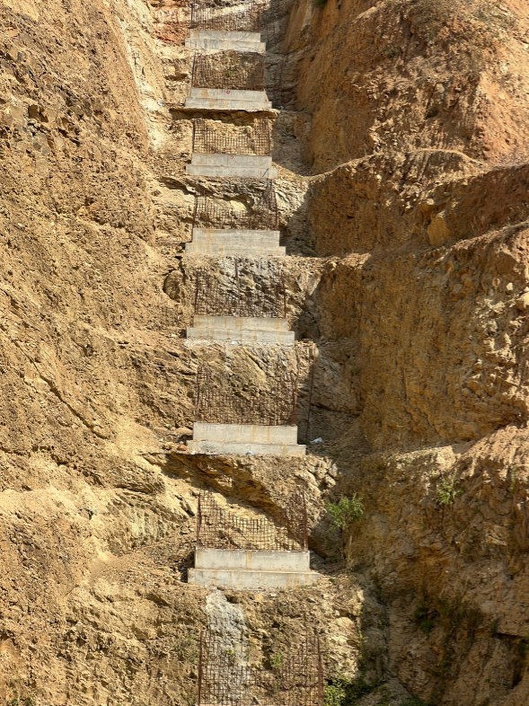
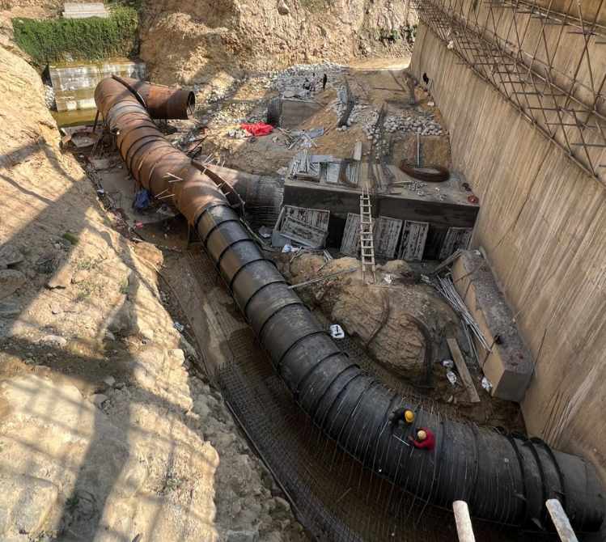
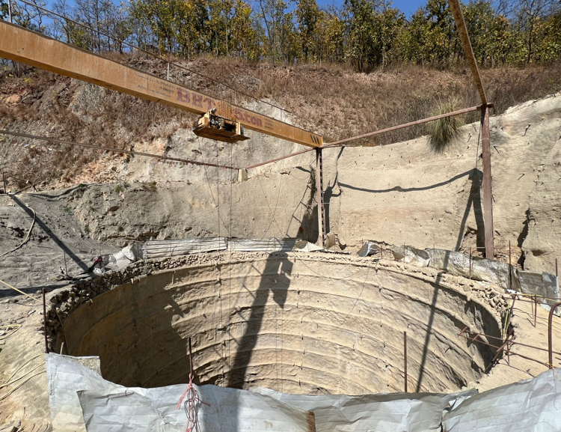
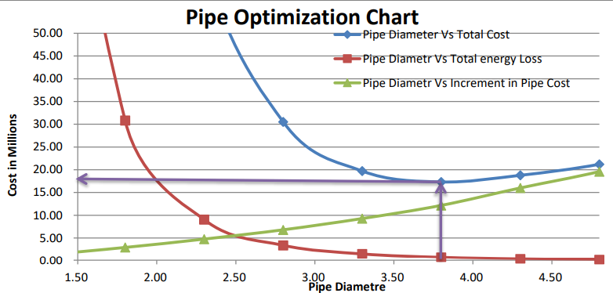
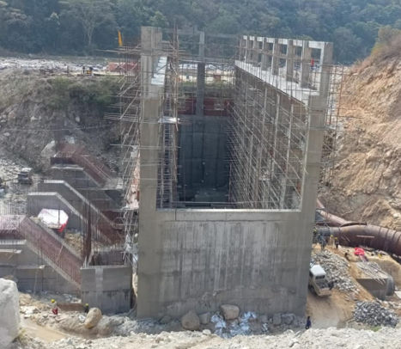
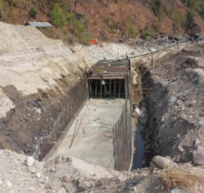
KATHMANDU UNIVERSITY
School of Engineering Department of Civil Engineering
Hydropower Internship Program : Kabeli – A Hydroelectric Project (37.6 MW)
Introduction
Task Performed
The Kabeli-A Hydroelectric Project (KAHEP) is a 37.6 MW Run-of-river plant located in Panchthar and Taplejung districts of Nepal. It lies between 27°10'–27°13'N latitude and 87°53'–87°55'E longitude, using a gross head of 120.50 meters. The project costs about NPR 7.5 billion and generates 216.4 GWh annually. It is developed by Kabeli Energy Limited, a subsidiary of Butwal Power Company Ltd and Arun Valley Hydropower Development Company Ltd .
Monitored construction stages of key components: intake, settling basin, tunnels, surge shaft, penstock, powerhouse, and tailrace.
Inspected reinforcement, formwork, and embedded parts before concrete placement.
Observed concrete works including plum concreting, compaction, and finishing to ensure quality standards.
Study of cad drawing ( Civil , Structural and Mechanical )
Performed lab tests such as:
Slump test and compressive strength test for concrete.
Ultrasonic Testing (UT), Dye Penetration Test (DPT), and welding inspections for penstock pipe
Studied Bar Bending Schedule (BBS) to review reinforcement detailing and estimate steel quantities.
Gained office experience in Cost estimation, project documentation, and construction drawing interpretation.
Salient Features
Photo 1: Project Location
Project Name
Type Of Development
Location
Installed Capacity
Gross Head
Rated Head
Catchment area at Intake
Design Discharge (Q₄₀)
Design Flood (Q_{100 year} )
Type of Additional Intake
Settling Basin
Headrace Canal
Head pond
Headrace tunnel
Water Conveyance
System
Surge Shaft
Penstock
Powerhouse
Turbine
Project Cost
Developer
Consultants
Contractor
: Kabeli –A HEP
: Cascade ROR
: Panchthar and Taplejung
: 37.6 MW
: 120.50 m
: 115.28 m
: 713.90 km²
: 37.23 m³/s
: 1020 m³/s
: Side Intake ( With 3 intake gates )
: Simple Rectangular with Sedicon Flushing System
: RCC Box Culvert (4.25 m x 4.25 m )
: Rectangular Concrete lined
: Inverted D shaped (4657 m long )
: Headrace canal and Headrace Tunnel (Inverted D
Type)
: Underground and Exposed to surface Semi Surface
: Mild steel (3.8 m dia )
: Semi Underground powerhouse
: Horizontal Axis Francis (3 units)
: NRs. 7.5 billion
: Kabeli Energy Ltd. (KEL)
: Units Engineering Consultancy : Zambala Construction Pvt Ltd, Paramax
Constructions, Sherpa Hydro Constructions
Analysis
Analysis defined roles and coordination among client, consultant, and contractor. Delegation and supervision between contractor and subcontractor.
Use of technical terms and site-specific procedures (e.g., MCT, BBS).
Contractor-side delays in procurement and material management.
Design alterations due to local geological, topographical, and community issues.
Economic-driven modifications in construction planning and methods.
External interferences, accidents, and site accessibility challenges.
Field learnings, adaptive lifestyle, and hardships of remote site deployment.
Photo 2: Interconnection Chamber
Photo 3: Additonal Intake Gate
Photo 4: Approach Canal
Photo 5: Headrace Canal
Conclusion
Our internship at the Kabeli-A Hydroelectric Project was a valuable experience that strengthened our technical and practical skills. We gained hands-on exposure to activities like concreting, BBS analysis, and surveying. It improved our communication, teamwork, and problem-solving abilities. The internship successfully met its objectives and prepared us for future roles in hydroelectric engineering.
Objectives
References
To get exposure to engineering duties and responsibilities .
To develop the proficiency to function in diverse engineering and managerial setting based on core knowledge , skills , attitude and aptitudes acquired during the in-campus semester .
To be aware of engineering norms ,values and ethical practices .
To be familiar with site work and inspection .
Photo 6: Settling Basin
Photo 7: Headpond
Final DPR KAHEP Report. (n.d.). [PDF document].
Kabeli Energy Limited. (n.d.). Kabeli-A Hydroelectric Project. https://www.kel.com.np/
Butwal Power Company Ltd. (n.d.). Kabeli-A Hydroelectric Project. https://www.bpc.com.np/projects/kabeli-a-hydro-electric-project
Photo 8: Scaffolding Placement
Photo 9: Plum Concreting
Photo 10: HRT Inlet portion
Photo 11: Tunnel Failure Section
1.39
Photo 13: Base Concreting
Photo 12: Catchment Area
Photo 14: Saddle Support
Photo 19: Pipe Optimization Chart
Photo 15: Penstock Unit Bifurcation
Photo 16: Surge shaft
Photo 17: Pipe Optimization Chart
Photo 18: Powerhouse
Photo 19: Tailrace
Group no : 06 Group Members : Sarita Sapkota (44) , Dharambir Yadav (58) , Rajesh Babu Yadav (59) , Shrija Shrestha (62)
Site Supervisor : Er. Lakpa Sherpa Office Work Supervisor : Er. Gopal Thapa Internal Supervisor : Asst. Prof. Santosh Chaudhary

